Slide 1














Non-Parametric Test
Kolmogorov-Smirnov Test (KS Test)
Jeet Nakrani

Slide 2
Content
01
02
03
04
Introduction
Formula
Steps
Example and Conclusion

Slide 3

Introduction
The Kolmogorov-Smirnov (KS) Test is a non-parametric statistical test used to determine whether a sample of data follows a specific distribution or if two samples originate from the same distribution. It compares the cumulative distribution function (CDF) of the observed data with the theoretical distribution.
Key Objectives:
Test for Goodness of Fit: - Determines if the sample data conforms to a predefined theoretical distribution (e.g., Normal, Poisson, or Exponential distribution).
Compare Two Distributions: - In its two-sample form, the KS Test can compare whether two datasets come from the same distribution.
Evaluate Statistical Significance: - Measures the largest difference between the cumulative frequencies of observed and expected data to evaluate if the difference is statistically significant.

Slide 4

Formula
Dn = max∣Fe/N​−Fo/N​∣
Where:
Fe​:- Expected cumulative frequency
Fo​:- Observed cumulative frequency
n: Sample size
N: Total Frequency
|Fo/N - Fe/N|: The absolute difference between the relative observed and expected cumulative frequencies.

Slide 5

Steps
Step 1: -
Step 2:-
Null Hypothesis (H₀): The given frequency data follows a known distribution.
Alternative Hypothesis (Hₐ): The given frequency data does not follow the known distribution.
Calculate the expected frequencies (Fe​) and observed frequencies (Fo​).
Compute the KS statistic Dn=max⁡∣Fe/N − Fo/N∣
Step 3: -
Step 4: -
Compare Dn with the standard KS critical value.
If Dn < Standard KS value → Accept Ho
Else → Reject Ho
Conclude your decision and write the inference you got.

Slide 6
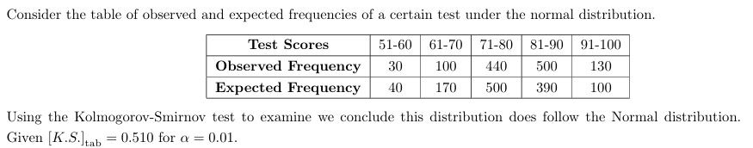
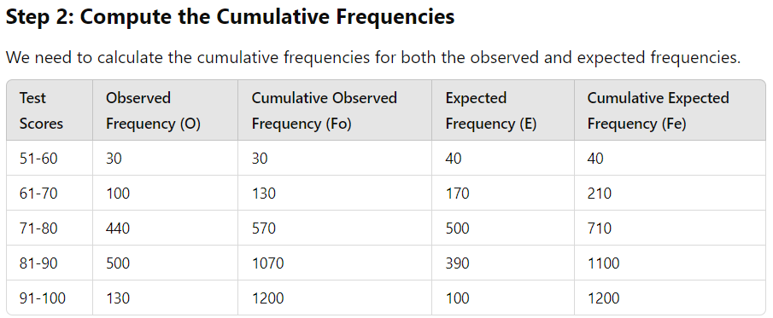
Example Sum
Step 1: Formulate the Hypotheses
Null Hypothesis (H₀): The observed data follows a normal distribution.
Alternative Hypothesis (Hₐ): The observed data does not follow a normal distribution.

Slide 7
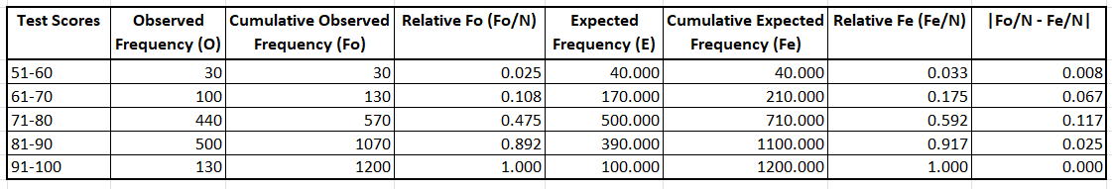
Example Sum
Step 3: Compute the Relative Cumulative Frequencies
Convert the cumulative frequencies into relative cumulative frequencies by dividing each cumulative frequency by the total frequency (1200 for both observed and expected).
Step 4: Calculate the Kolmogorov-Smirnov Statistic (Dₙ)
The KS statistic DnD_nDn​ is the maximum absolute difference between the relative cumulative frequencies.
Dn=max⁡∣Fo/N−Fe/N∣=max⁡(0.008,0.067,0.117,0.025,0.000)= 0.117
Step 5: Compare with the Critical Value
Given KS critical value from the table (α=0.01\alpha = 0.01α=0.01): 0.510
Calculated Dn=0.117
Step 6: Make a Decision
If Dn < Critical Value: Accept H₀​ (the data follows a normal distribution).
If Dn ​≥ Critical Value: Reject H₀ (the data does not follow a normal distribution).
Since 0.117<0.510, we accept the null hypothesis (H₀) and conclude that the observed distribution follows the normal distribution.

Slide 8

Advantages
Non-parametric: No assumptions about data distribution.
Simple to compute: Easy to interpret the maximum difference between observed and expected CDFs.
Applicable to small samples: Works well with limited data.
Versatile: Used for one-sample and two-sample tests.
Widely applicable: Used in quality control, finance, and model validation.
Drawbacks
Sensitive to sample size: Large samples may detect insignificant differences.
Low sensitivity to small deviations: May miss small differences, especially in distribution tails.
Primarily for continuous data: Not ideal for discrete or multivariate data.
Assumes independent data: Results may be invalid if data points are dependent.

Slide 9

Final Python Code
Python Code Link Click Me

Slide 10
Thank you very much!

